Slide 1
A Project Progress Report on “Automatic Bengali News Generation”
Machine Learning (MS - CSE 533)
North South University
Presented by:
S.M. Shahadat Hossain (St. ID: 1935 190 650)

Slide 2
Automatic Bengali News Generation – Overview
Target: Automatically generate a piece of news article using a collection of articles
Figure: Sample Architecture for Text
Generation with LSTM Network
Seed
LSTM
Clean Data
Tokenized Data
Output
Raw Data
LSTM
LSTM
LSTM
Generated Document

Slide 3
Automatic Bengali News Generation – Work Progress
Figure: Bengali Text Generation with
LSTM Network Work Progress
Seed
LSTM
5 Bengali News Articles
Cleaned data
Tokenized & 1 Hot Encoded
Output
LSTM
LSTM
LSTM
Generated Document

Slide 4
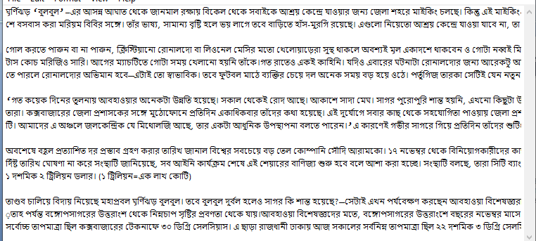
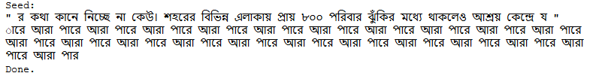

Automatic Bengali News Generation – Sample Input - Output
Sample Input
After 10 epoch
After 25 epoch

Slide 5
Automatic Bengali News Generation – References
Related Works:
https://machinelearningmastery.com/text-generation-lstm-recurrent-neural-networks-python-keras/
Keras code example of LSTM for text generation
https://github.com/irdanish11/Sentence-Prediction-using-LSTMs_aka-Language-Modeling
LSTM text generation using word
Used to generate multiple sentence suggestions based on the input words or a sentence.

